Slide 2
Java Basics
TDD, Refactoring to patterns testing tool & more…
Java workshop training, August,2017.
Dr. Kishore Biswas (Forrest/柯修)
PhD. Artificial Intelligence—Natural Language Processing.
CanWay IT Training ®.

Slide 3
1. TDD 2. Refactoring to patterns & Common code smells 3. Write testable codes. 4. Learn to use testing tool, e.g. JUnit, Mockito for Java side

Slide 4
1. Test Driven Development TDD

Slide 5
WARNING
These slides are not optimized for printing or exam preparation. These are for lecture delivery only.
These slides are made for PowerPoint 2010. They may not show up well on other PowerPoint versions. You can download PowerPoint 2010 viewer from here.
These slides contain a lot of animations. For optimal results, watch in slideshow mode.

Slide 6

[Extra] 100 fish
How long will they take to catch all fish?
Less than 1 hour
Around 1 hour
About 100 hours
Forever
If 100 people trying to catch 100 piranha fish.
On average, one person can catch one fish within 1 hour

Slide 7


[Extra] 100 fish
How long will they take to catch all fish?
Less than 1 hour
Around 1 hour
About 100 hours
Forever
If 100 people trying to catch 100 piranha fish.
On average, one person can catch one fish within 1 hour

Slide 8
[Extra] 100 fish
How long will they take to catch all fish?
Less than 1 hour
Around 1 hour
About 100 hours
Forever
If 100 people trying to catch 100 piranha fish.
On average, one person can catch one fish within 1 hour

Slide 9
System testing
SUT

Slide 11
System testing
SUT

Slide 12
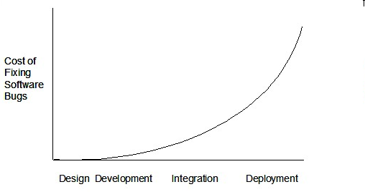
System testing
SUT

Slide 13

[Extra] who wants maximum publicity
Do you want maximum publicity for your mistakes?

Slide 14
[Extra] who wants maximum publicity
Do you want maximum publicity for your mistakes?

Slide 15
Never too early to test:
An Introduction to Early Developer Testing

Slide 16
MSLogic
Unit testing
History
UI
UI
MSLogic
History
Storage
Storage

Slide 17
MSLogic
Unit testing
History
UI
UI
MSLogic
History
Storage
Storage

Slide 18
Unit testing
SUT
UI
MSLogic
History
Storage

Slide 19

Unit testing
SUT
UI
MSLogic
History
Storage

Slide 20
Unit testing
Test Driver
SUT
Stub
UI
MSLogic
History
Stub
Storage

Slide 21
Unit testing
SUT== MSLogic
UI
MSLogic
History
Stub
Storage
String retrieveFromDatabase (int key){
if(key==1) return “Item for key 1”;
if(key==2) return “Item for key 2”;
…

Slide 22
Unit testing
Test Driver
SUT== MSLogic
UI
MSLogic
History
Stub
Storage
String item = msLogic.getItem(1);
if(!item.equals(“Item1”) print(“Case 1 failed”);
…

Slide 23

Unit testing
Test Driver
SUT== MSLogic
UI
MSLogic
History
Stub
Storage
String item = msLogic.getItem(1);
if(!item.equals(“Item1”) print(“Case 1 failed”);
…

Slide 24
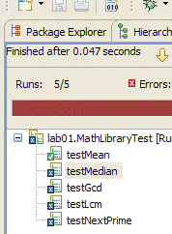
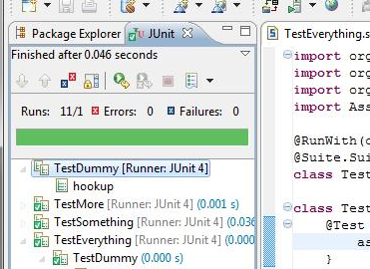
String item = msLogic.getItem(1);
if(!item.equals(“Item1”) print(“Case 1 failed”);
…
Testing frameworks
assertEquals(msLogic.getItem(1), “Item1”);
JUnit (Java)
Visual Studio Native Tests (C++)

Slide 25
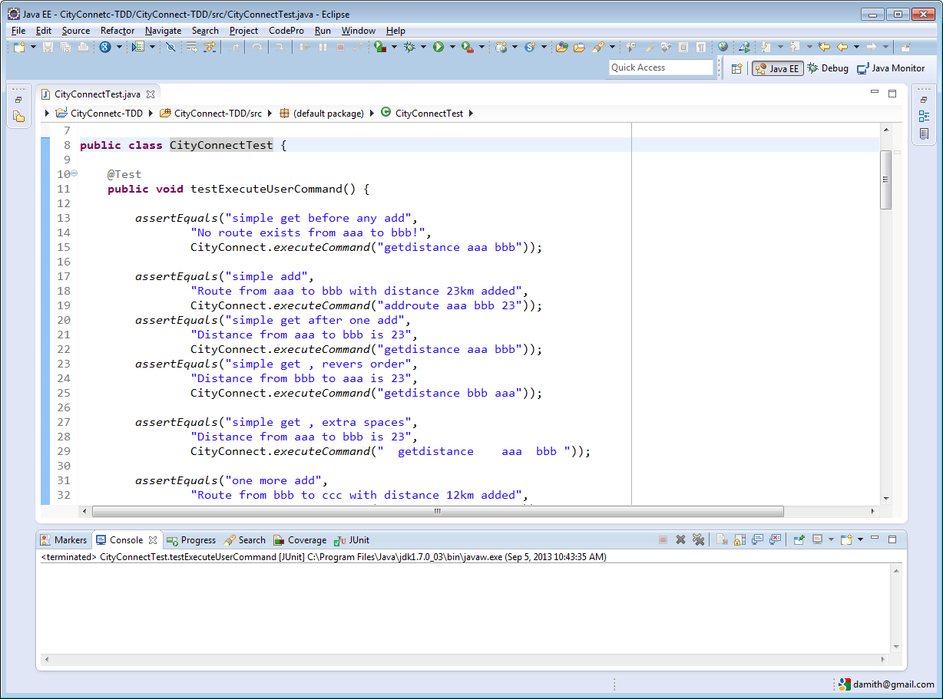

Slide 26
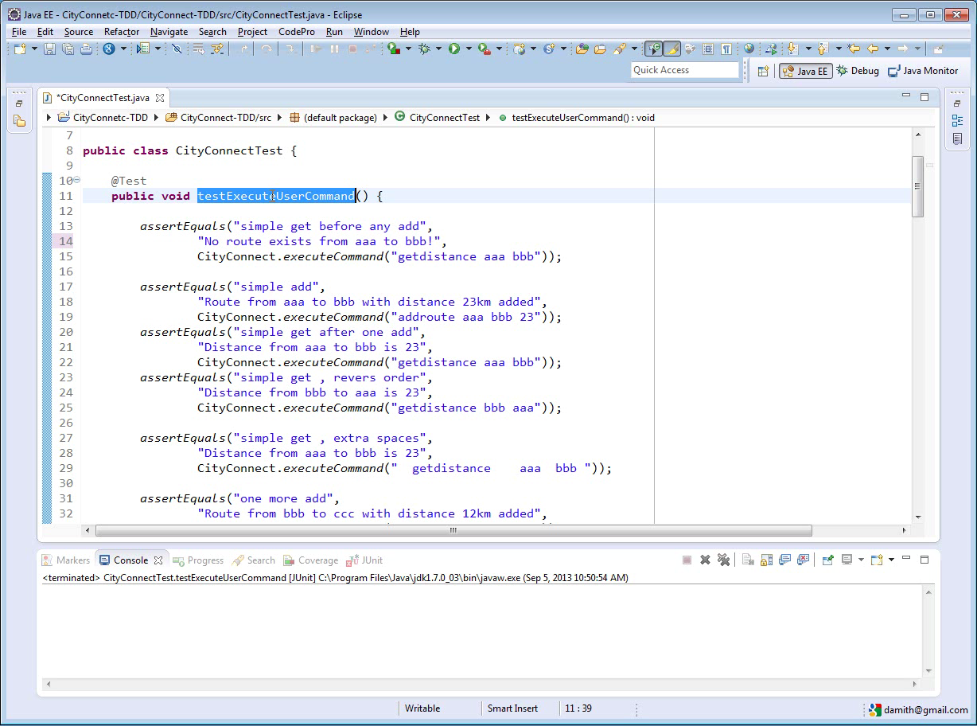

Slide 27
Unit testing
UI
MSLogic
History
Storage

Slide 28
Unit testing
UI
MSLogic
History
Storage

Slide 29
Integration testing
UI
MSLogic
History
Storage

Slide 30
Integration testing
UI
MSLogic
History
Storage

Slide 31
Integration testing
UI
MSLogic
History
Storage

Slide 32
Integration testing
UI
MSLogic
History
Storage

Slide 33

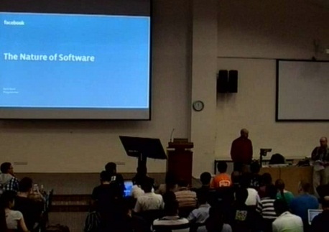

Test-Driven Development (TDD)
SUT

Slide 34
Test-Driven Development (TDD)
SUT

Slide 35
Test-Driven Development (TDD)
Write a failing test
Write code to pass test

Slide 36
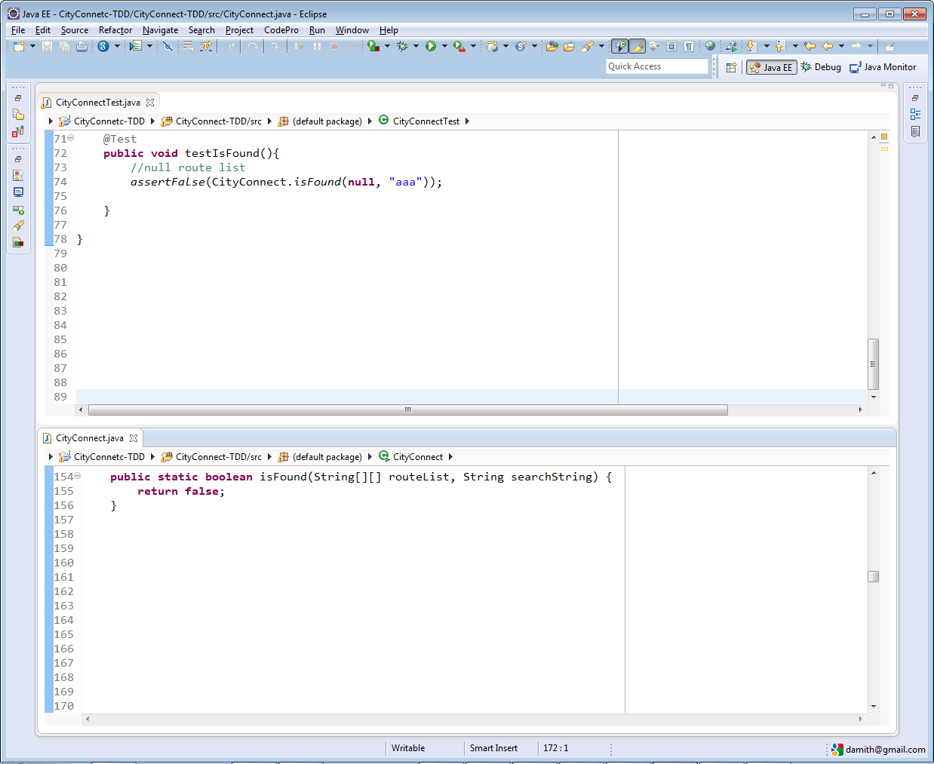
CityConnectTest.java
CityConnect.java

Slide 37
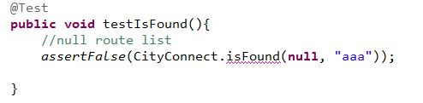
CityConnectTest.java
CityConnect.java
Clementi → true
Novena → true
Eunos → true
Changi → false
Clementi, Eunos, 20
Eunos, Novena, 40
Write the java/c++/pseudo code for the above
Notes:
We want have this.

Slide 38
CityConnectTest.java
CityConnect.java
Notes:
But, we are not going to write it at first.

Slide 39
CityConnectTest.java
CityConnect.java

Slide 40
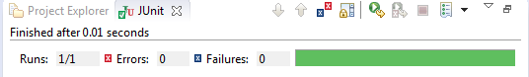
CityConnectTest.java
CityConnect.java

Slide 41
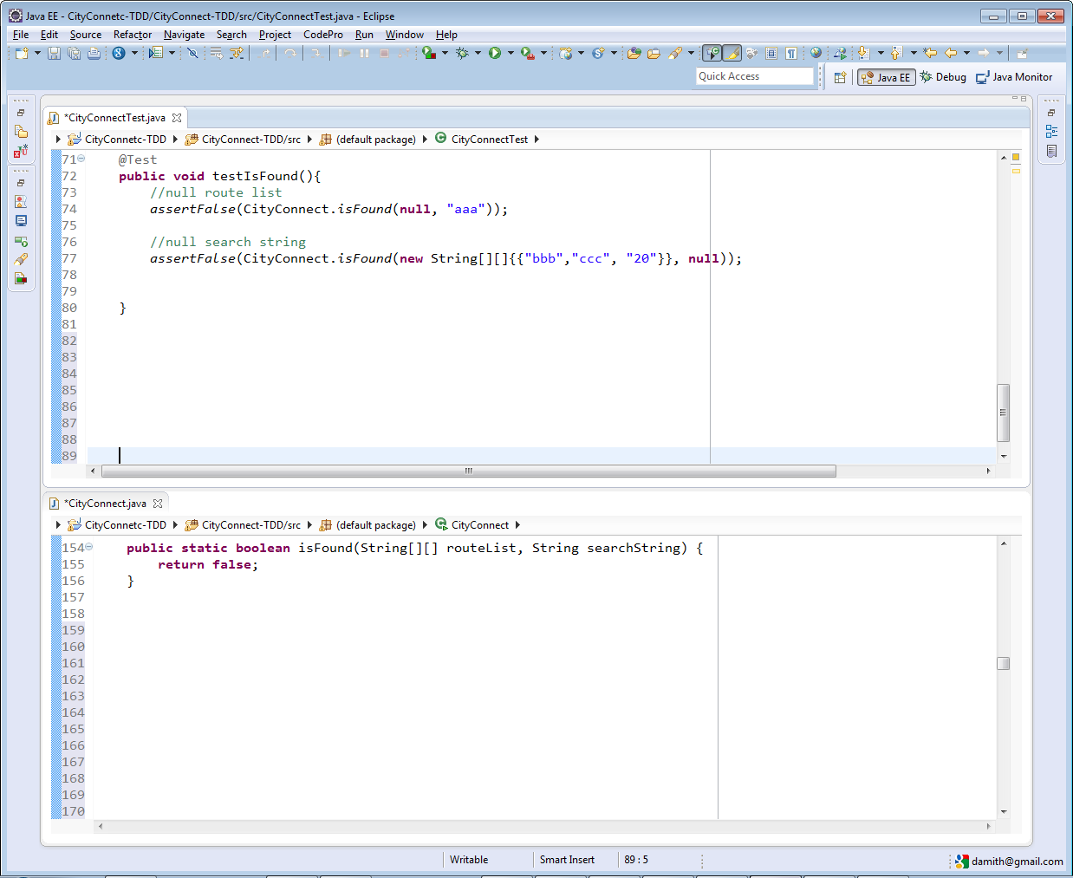
CityConnectTest.java
CityConnect.java

Slide 42
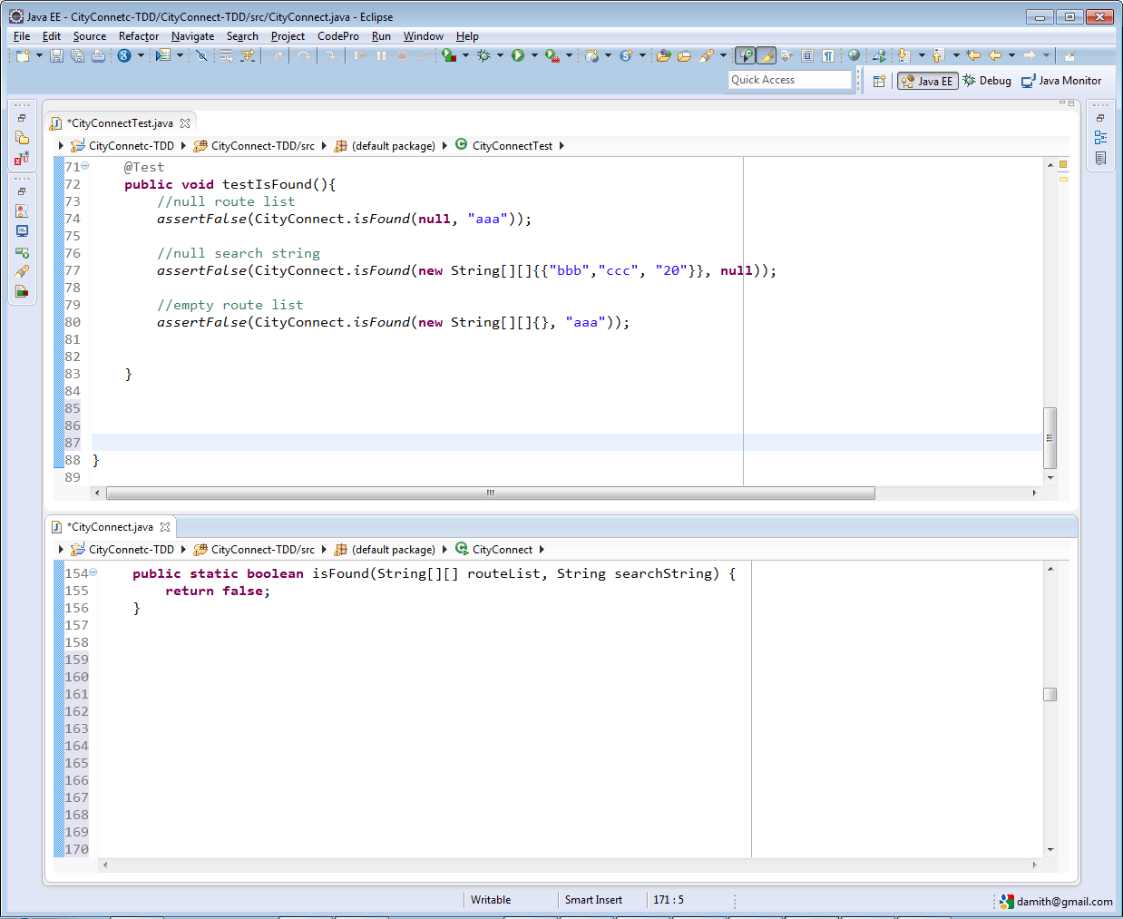
CityConnectTest.java
CityConnect.java

Slide 43
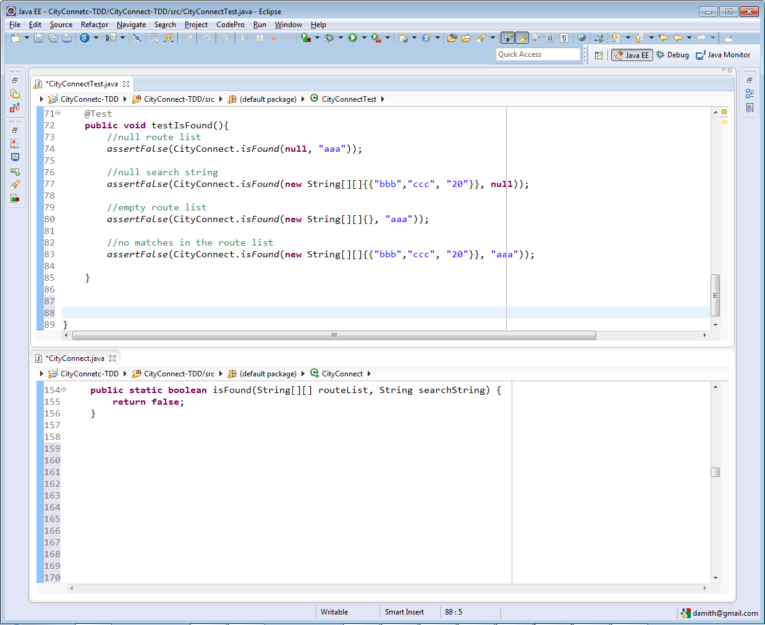
CityConnectTest.java
CityConnect.java

Slide 44
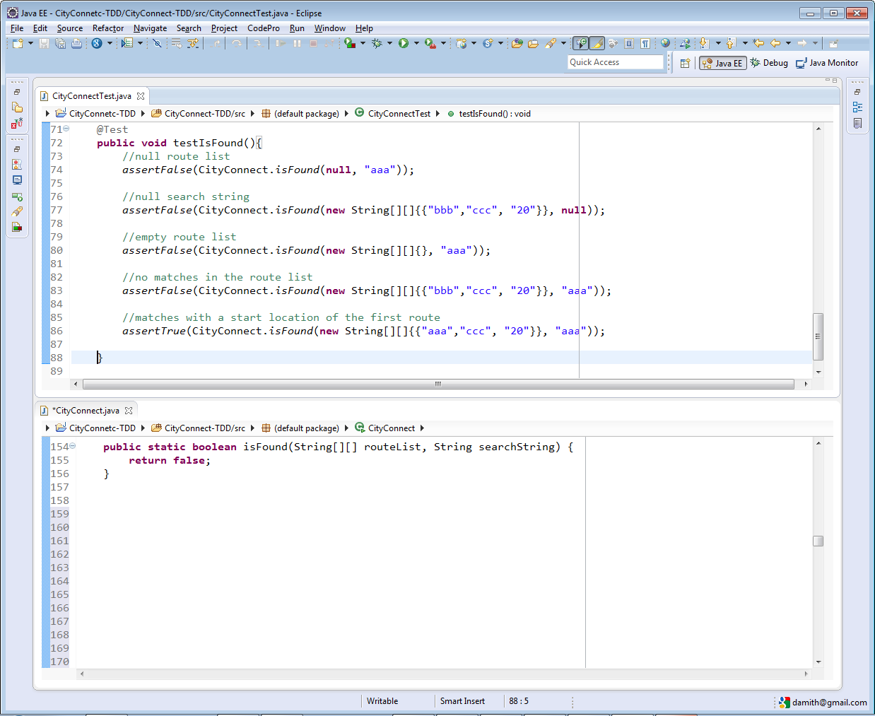
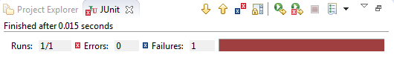
CityConnectTest.java
CityConnect.java

Slide 45
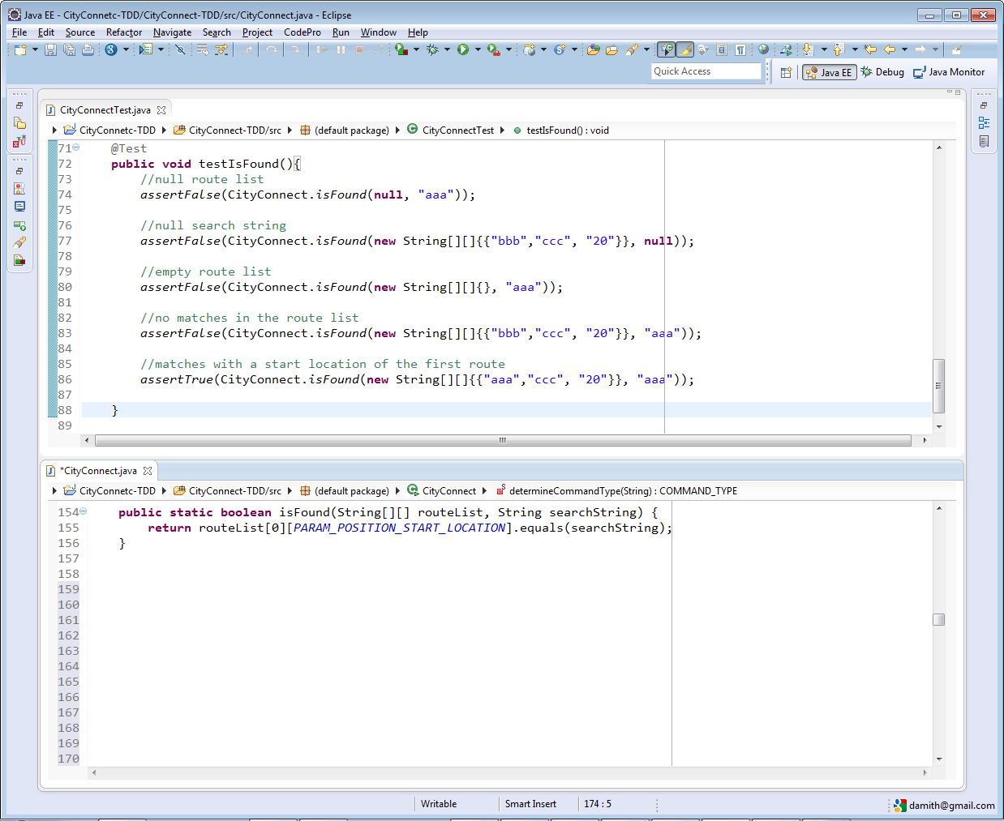
CityConnectTest.java
CityConnect.java

Slide 46
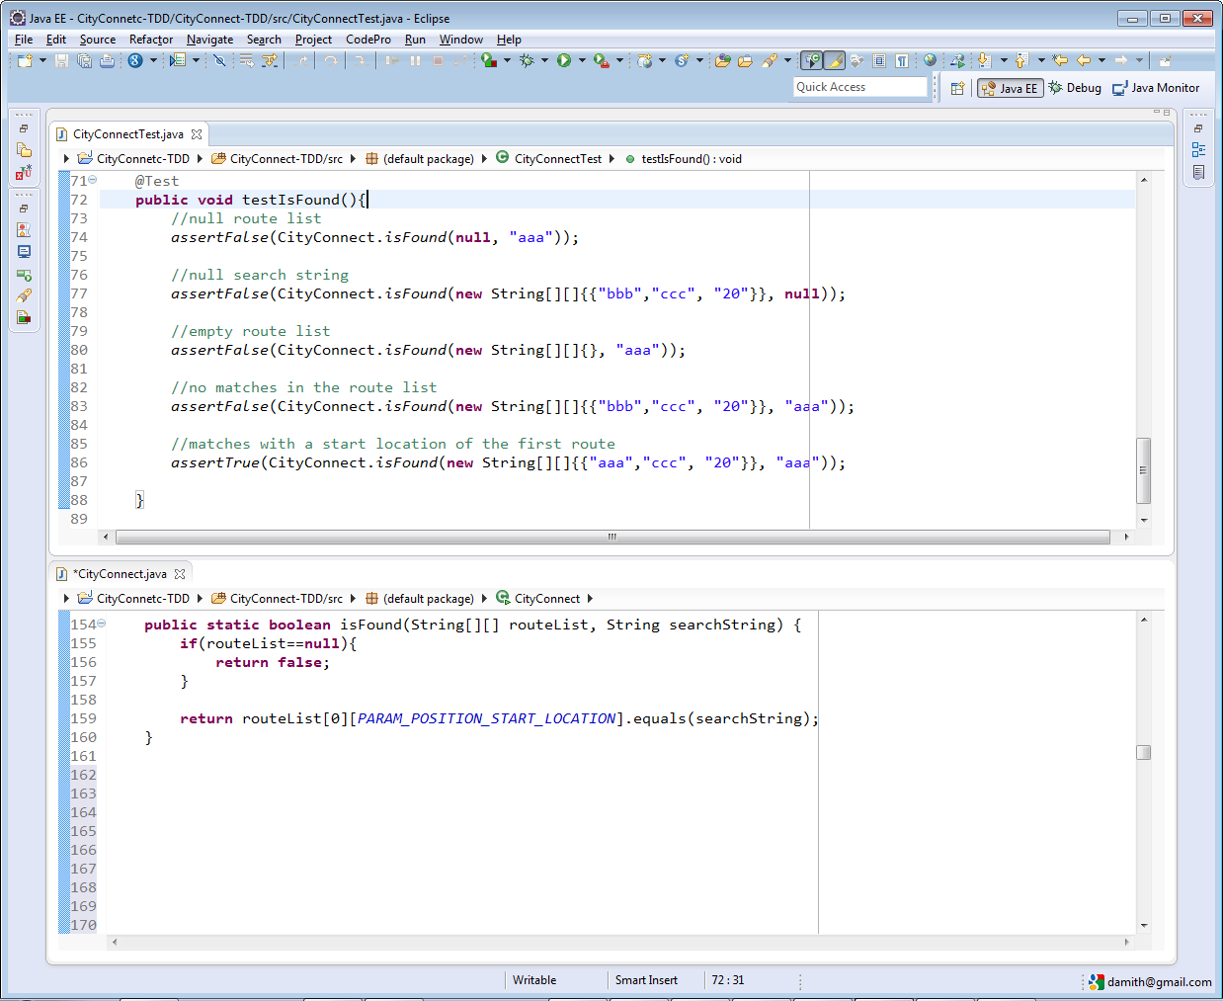
CityConnectTest.java
CityConnect.java

Slide 47
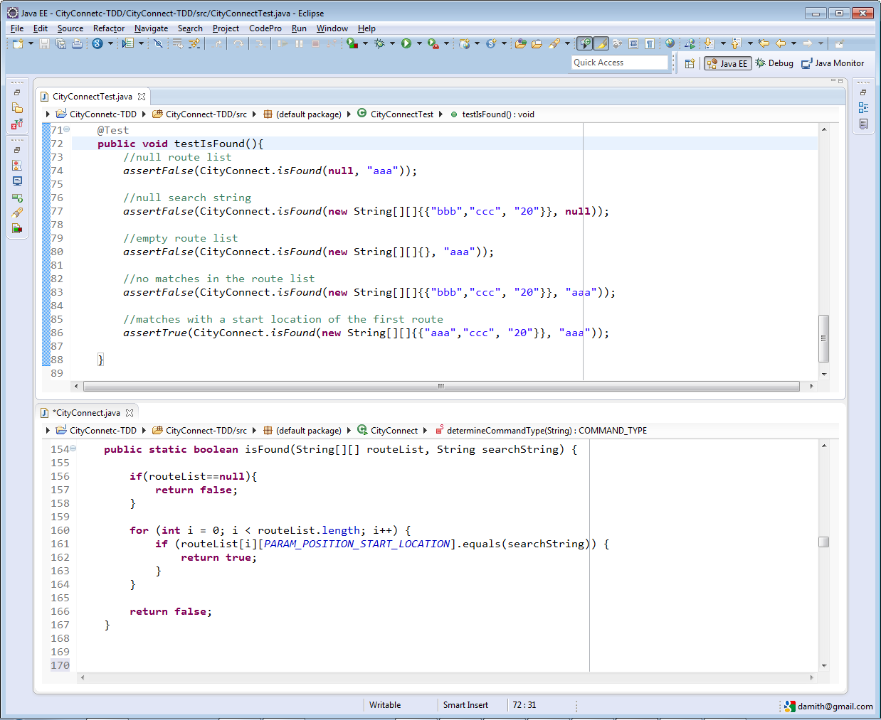
CityConnectTest.java
CityConnect.java

Slide 48
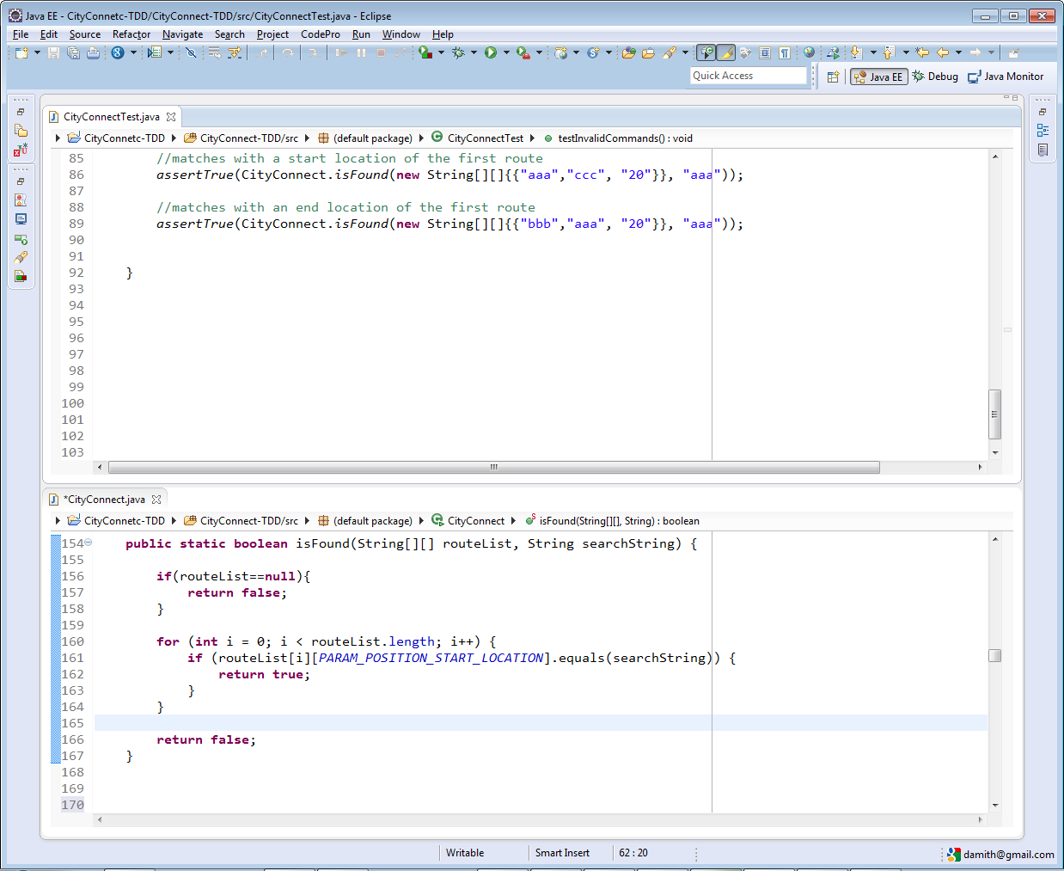
CityConnectTest.java
CityConnect.java

Slide 49
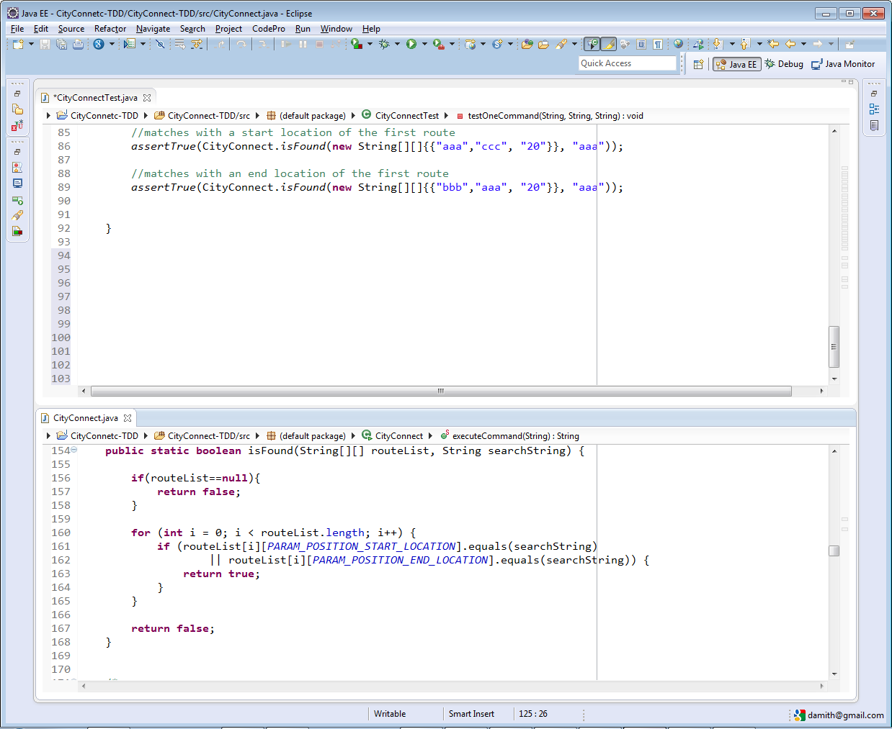
CityConnectTest.java
CityConnect.java

Slide 50
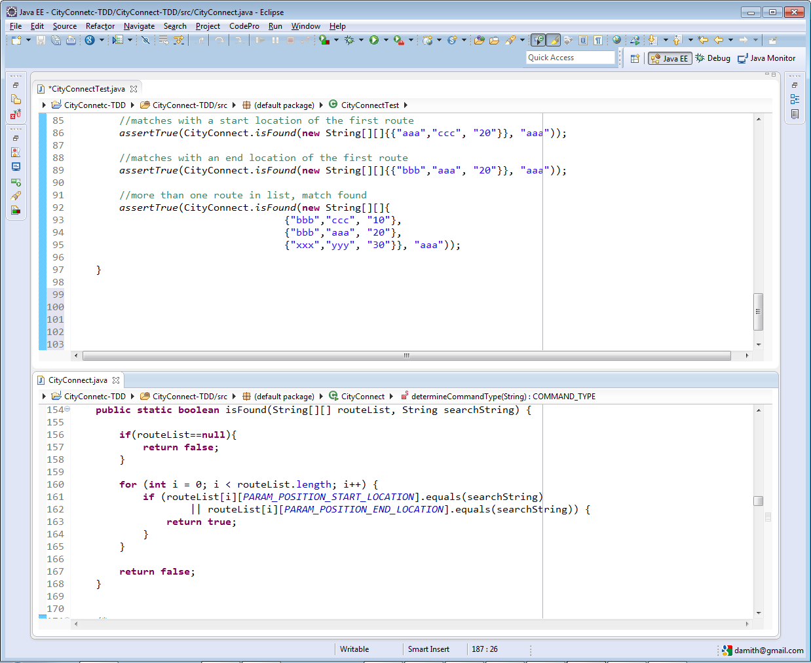
CityConnectTest.java
CityConnect.java

Slide 51
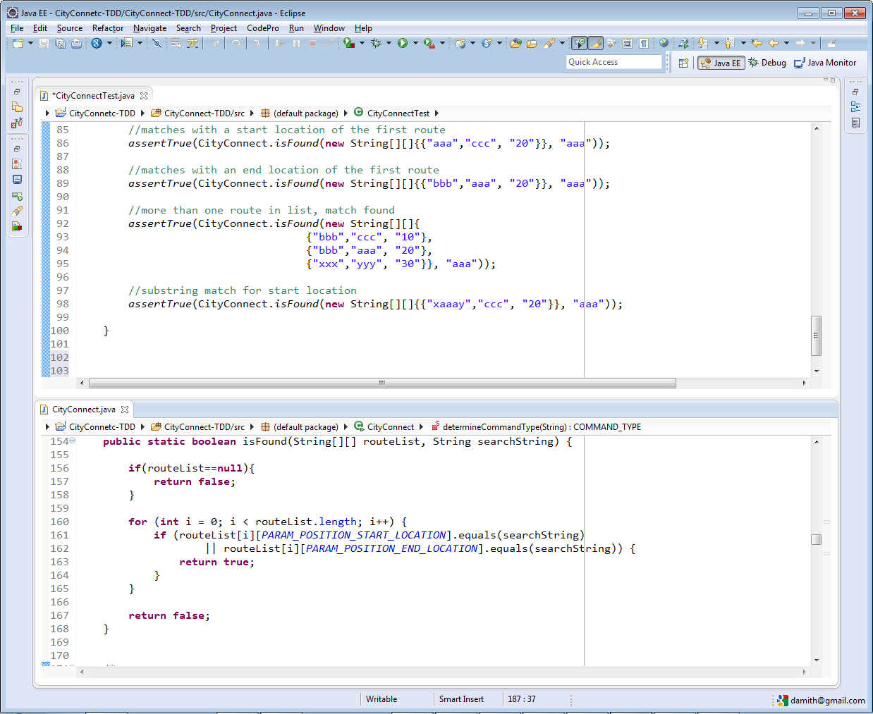
CityConnectTest.java
CityConnect.java

Slide 52
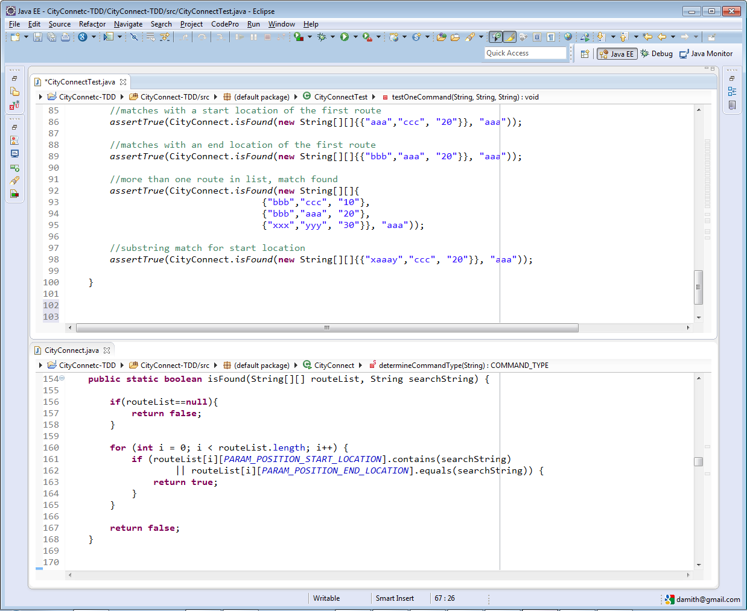
CityConnectTest.java
CityConnect.java

Slide 53
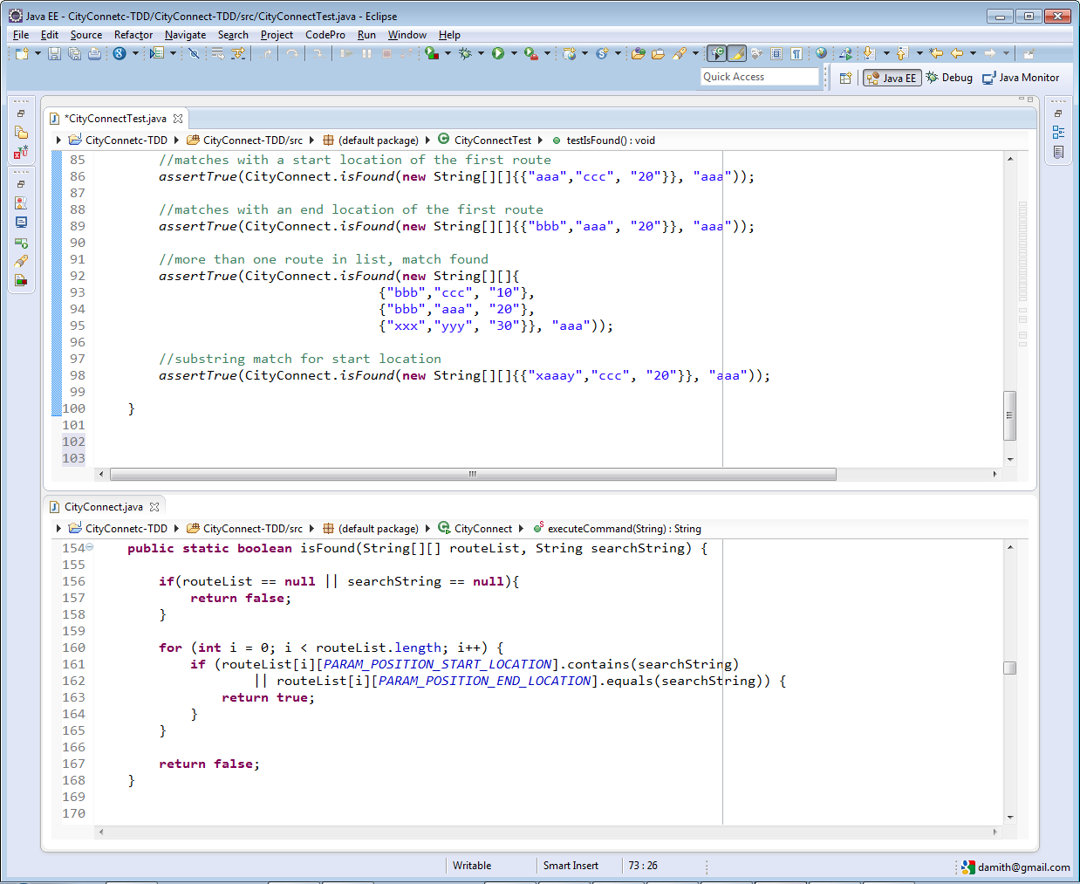
CityConnectTest.java
CityConnect.java

Slide 54
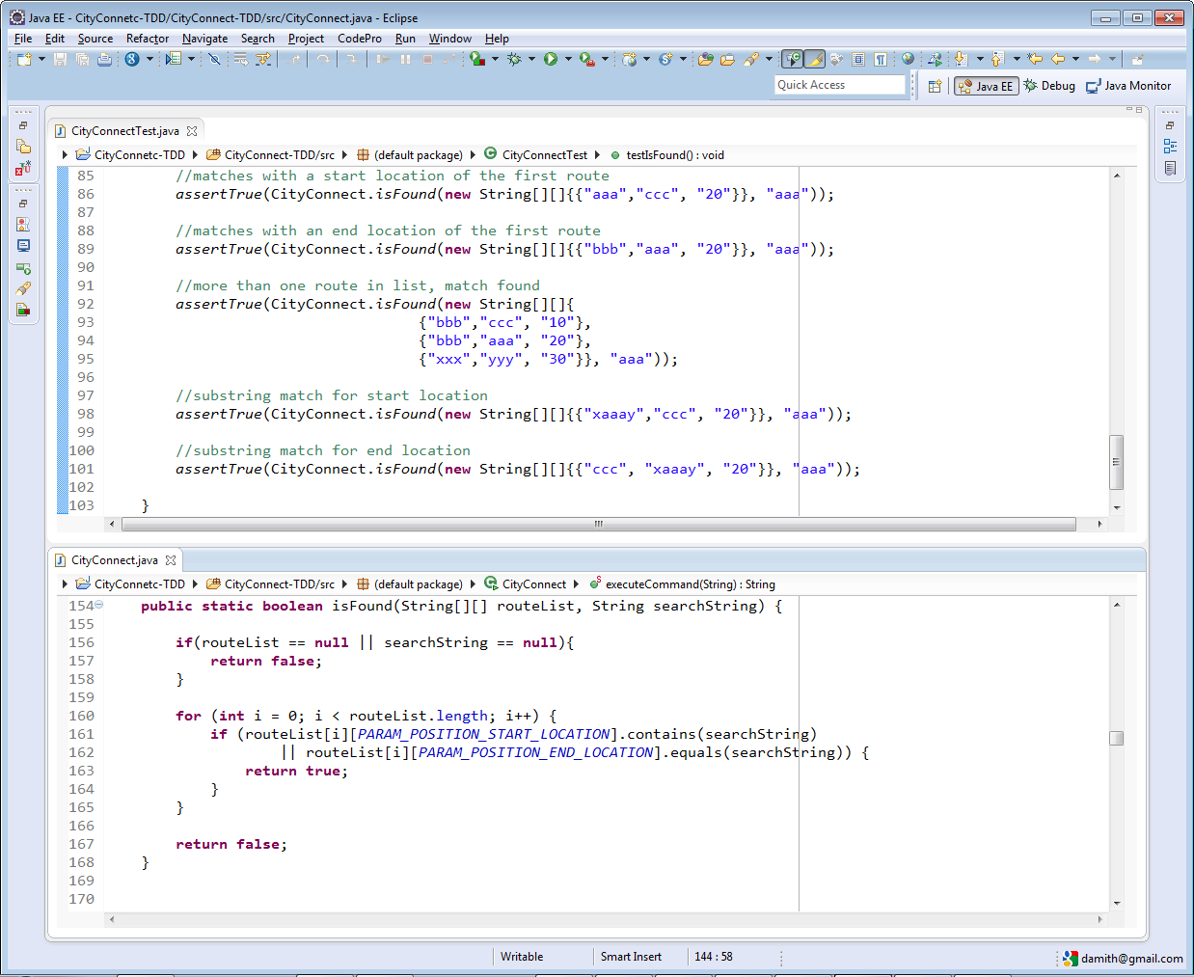
CityConnectTest.java
CityConnect.java

Slide 55

CityConnectTest.java
Note: more test cases required.
CityConnect.java
Refactor as necessary.

Slide 56
Test-Driven Development (TDD)
Write a failing test
Write code to pass test

Slide 57
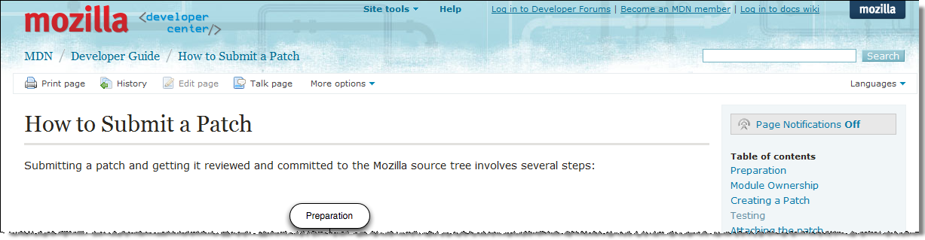
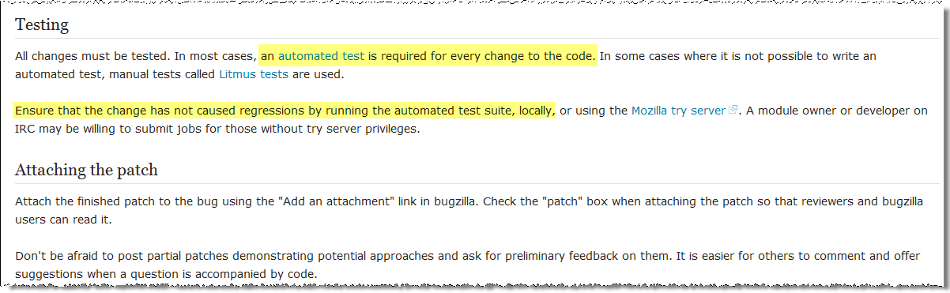
[extra] Mozilla patch policy

Slide 58
[Extra] who wants maximum publicity
Do you want maximum publicity for your mistakes?
When the system test fails...

Slide 59

↙ ?
Must have automated developer tests!

Slide 60
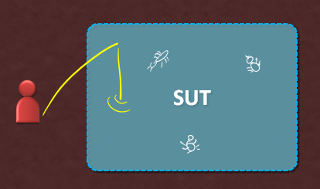
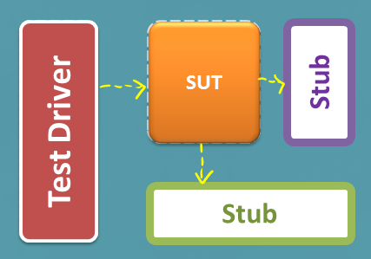
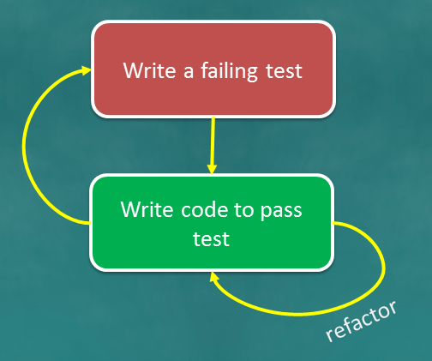
It can save your reputation.
Must do developer testing
Can do in TDD fashion
Only system testing? NO
Use automated test driver frameworks

Slide 61
↙ ?
Should do this too
Everyone should do some
Try in CE2,
Optional in project
Use these

Slide 62




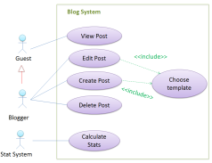
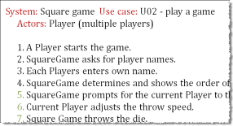
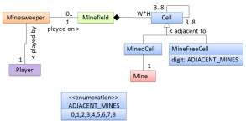
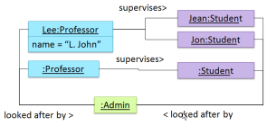
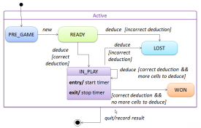
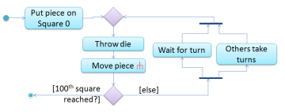
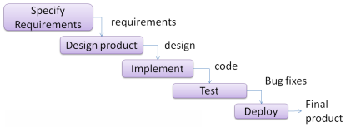
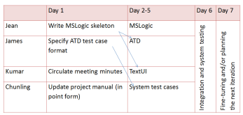
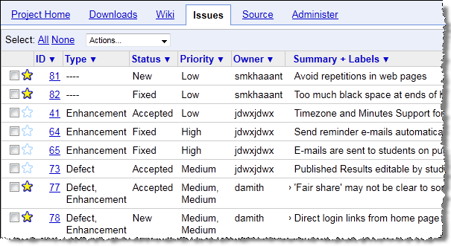
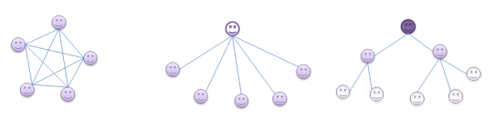

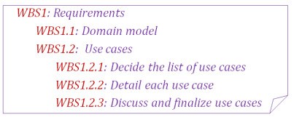
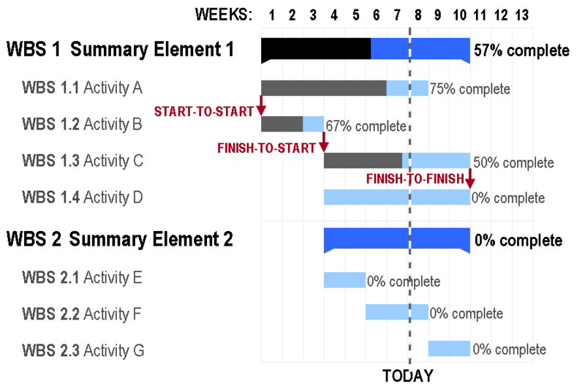
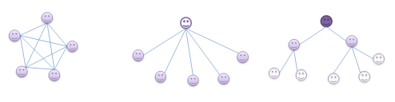
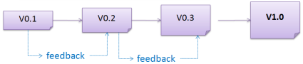
ANALYSIS
We use OO to ‘align the view’.
We use UML as the standard notation.
DESIGN
IMPLEMENTATION
QUALITY ASSURANCE
(Complex) Problem domain
Stakeholders
IDEs, Debugging
RCS
= Validation & Verification
Establish requirements…
brainstorming
Focus groups
User surveys
Product surveys
Observations
Interviews
Prototyping
System Specification
A
B
D
C
Architecture
Unit testing
A
C
A
B
Can be top-down, bottom-up, sandwich, big-bang
D
D
Architecture styles such as n-tier, client-server, peer-to-peer, broker, pipes-and-filters, service-oriented, transaction-processing, and MVC
Integration
Combat complexity…
Use abstraction, build models
B
Sequence diagrams
Developer testing
Other V&V techniques:
formal verification
static analyzers
code reviews
…
Can be late-one-time, or early-and-continuous
Specify requirements…
Textual descriptions
Feature list
User stories
Use cases
OO domain models
Object diagrams
State machine diagrams
Activity diagrams
UI prototypes
Glossary
Supplementary requirements
…
Top-down design
Integration testing
API (Application Programming interface)
Testing
B
After modifications… Regression testing
QA
x
y
Class diagrams
y
Framework
System testing
Detailed design
Detailed design
z
Bottom-up design
System
Test cases
x
z
Library
operations
More agile -> less upfront detailed design
Platform
Made up as you go → Exploratory testing
Predetermined → Scripted testing
Can be created in these ways:
Black-box, Glass-box, Grey-box
User
Acceptance testing
Alpha/beta testing
Detailed design
Detailed design
Detailed design
Possible Improvements:
Refactor code
Coding standards and good coding practices
Protect code using assertions, exceptions, logging, and defensive coding.
Build automation
Possible Improvements:
Automate testing
Use Test-Driven Development
Increase efficiency and effectiveness of testing (Equivalence partitioning, Boundary Value analysis)
Increase test coverage (function/entry/exit/statement/branch/ condition/path coverage)
isolate SUT using drivers, stubs and dependency injection
Possible Improvements:
↑Cohesion, ↓Coupling
Apply design patterns (Abstraction Occurrence, Singleton, Command, Observer)
Apply design principles (Open/close, Law of Demeter, Separation of concerns, …)
Use polymorphism (inheritance, interfaces, dynamic binding)
Good product design guidelines (e.g., usability, …)
Possible Improvements:
Apply OO principles
Apply analysis patterns
Categorize and prioritize requirements
Requirements Specification
Sequential
Unified process
Project plans
Team structures
CMMI
Work-breakdown structures
PROJECT MANAGEMENT
Agile processes
Chief-programmer
Iterative
Issue trackers
Includes buffers and milestones
Egoless
Breadth-first
Depth-first
XP
Scrum
Strict hierarchy

Slide 63


Slide 65
Test Driven Development (TDD)
"TDD is emerging as one of the most successful developer productivity enhancing techniques to be recently discovered. The three-step: write test, write code, refactor – is a dance many of us are enjoying"
Eric Vautier, David Vydra
"TDD is the Gem of Extreme Programming"
Kent Beck

Slide 66
TDD: What is it?
TDD turns traditional development around
Write test code before the methods
Do so in very small steps
Refuse to add any code until a test exists for it
Have a failing test (red bar) before writing the code to make the test pass
You can run tests anytime
And you should do so quite often

Slide 67
Simple, yet hard to do
When you first try TDD, it requires great discipline because it is easy to “slip” and write methods without first writing a new test
Pair programming helps you to stay on track
Williams and Kessler

Slide 68
Comments, Documentation?
Most programmers don’t read documentation
instead they prefer to work with the code
Programmers often look for sample code that sends messages to instances of a class
Well-written unit tests can provide such a working specification of your code
more docs are necessary
Unit tests effectively become a significant portion of your technical documentation

Slide 69
Testing Framework
An underlying assumption of TDD is that you have a unit-testing framework
Good software developers use a testing framework such as JUnit
Many exist http://en.wikipedia.org/wiki/List_of_unit_testing_frameworks
Without a unit-testing framework, TDD is virtually impossible

Slide 70
TDD Helps Design
TDD makes you think about what you want or need before you write the code
pick class and method names
decide the needed arguments
choose return types
write the class, constructors, instance variables, and methods to make what you want work

Slide 71
Benefits of TDD
Benefits include
Rapid feedback
Interface before algorithm
Know when you’re finished
Change the code with confidence

Slide 72
Principles of TDD
You maintain an exhaustive suite of Programmer Tests
No code goes into production unless it has associated tests
You write the tests first
Tests determine what code you need to write if you are programming by intention
Then you are designing as you write tests

Slide 73
A unit test with 2 test methods
import static org.junit.Assert.*;
import org.junit.Test;
public class BankAccountTest {
@Test
public void testDeposit() {
BankAccount anAcct = new BankAccount("Zac", 1000.00);
assertEquals(1000.00, anAcct.getBalance(), 1e-12);
anAcct.deposit(0.52);
assertEquals(1000.52, anAcct.getBalance(), 1e-12);
}
@Test
public void testWithdraw() {
BankAccount anAcct = new BankAccount("Zac", 1000.52);
assertEquals(1000.52, anAcct.getBalance(), 1e-12);
anAcct.withdraw(10.52);
assertEquals(990.00, anAcct.getBalance(), 1e-12);
}
}

Slide 74
Annotations
Annotations provide data about a program that is not part of the program itself. Uses include
Information for the compiler
Annotations can be used by the compiler to detect errors or suppress warnings @SuppressWarnings("unused")
Compiler-time and deployment-time processing
Software tools can process annotation information to generate code, XML files
Runtime processing
examined at runtime @Test

Slide 75
JUnit Annotations
Useful annotations used by JUnit
@Test marks a test method
@Before and @After mark methods that execute before and after every test method in the unit test @BeforeClass marks a method that executes exactly once before any other annotated method in the unit test

Slide 76
import org.junit.*;
public class ShowFlowOfControl {
@BeforeClass
public static void beforeAllOthers() {
System.out.println("First one time");
}
@Before
public void beforeEachTest() {
System.out.println("Before");
}
@After
public void afterEachTest() {
System.out.println("After");
}
@Test
public void test1() {
System.out.println("one");
}
@Test
public void test2() {
System.out.println("two");
}
}
What is the output?

Slide 77
Assertions
Useful assertions that go into @Test methods
// Asserts that a condition is true public static void assertTrue(boolean condition)
public static void assertEquals(int expected, int actual)
public static void assertEquals (double expected,
double actual,
double err)
// Asserts that two Object objects are equal
public static void assertEquals(Object expected, Object actual)
All assertions of org.junit.Assert can be found at
http://www.junit.org/apidocs/org/junit/Assert.html

Slide 78
So why test code?
So we develop quality software that works
It can get you jobs
It's what good software developers do
It is very important to test your code
You can develop code in half the time
Gives you the power and confidence to refactor
To save lives and help avoid financial losses
Rick says you have to

Slide 79
2. Refactoring to patterns & Common code smells

Slide 80
3. Write testable codes.

Slide 81
4. Testing tool Junit & Mockito for Java

Slide 82
Test suites
Obviously you have to test your code to get it working in the first place
You can do ad hoc testing (testing whatever occurs to you at the moment), or
You can build a test suite (a thorough set of tests that can be run at any time)
Disadvantages of writing a test suite
It’s a lot of extra programming
True—but use of a good test framework can help quite a bit
You don’t have time to do all that extra work
False—Experiments repeatedly show that test suites reduce debugging time more than the amount spent building the test suite
Advantages of having a test suite
Your program will have many fewer bugs
It will be a lot easier to maintain and modify your program
This is a huge win for programs that, unlike class assignments, get actual use!

Slide 83
Example: Old way vs. new way
int max(int a, int b) { if (a > b) { return a; } else { return b; } }
void testMax() { int x = max(3, 7); if (x != 7) { System.out.println("max(3, 7) gives " + x); } x = max(3, -7); if (x != 3) { System.out.println("max(3, -7) gives " + x); } }
public static void main(String[] args) { new MyClass().testMax(); }
@Test void testMax() { assertEquals(7, max(3, 7)); assertEquals(3, max(3, -7)); }

Slide 84
XP approach to testing
In the Extreme Programming approach,
Tests are written before the code itself
If code has no automated test case, it is assumed not to work
A test framework is used so that automated testing can be done after every small change to the code
This may be as often as every 5 or 10 minutes
If a bug is found after development, a test is created to keep the bug from coming back
Consequences
Fewer bugs
More maintainable code
Continuous integration—During development, the program always works—it may not do everything required, but what it does, it does right

Slide 85
JUnit
JUnit is a framework for writing tests
JUnit was written by Erich Gamma (of Design Patterns fame) and Kent Beck (creator of XP methodology)
JUnit uses Java’s reflection capabilities (Java programs can examine their own code)
JUnit helps the programmer:
define and execute tests and test suites
formalize requirements and clarify architecture
write and debug code
integrate code and always be ready to release a working version
JUnit is not included in Sun’s SDK, but almost all IDEs include it

Slide 86
Terminology
A test fixture sets up the data (both objects and primitives) that are needed to run tests
Example: If you are testing code that updates an employee record, you need an employee record to test it on
A unit test is a test of a single class
A test case tests the response of a single method to a particular set of inputs
A test suite is a collection of test cases
A test runner is software that runs tests and reports results
An integration test is a test of how well classes work together
JUnit provides some limited support for integration tests

Slide 87
Once more, in pictures
test suite
test runner
another unit test
test case (for one method)
A unit test tests the methods in a single class
A test case tests (insofar as possible) a single method
You can have multiple test cases for a single method
A test suite combines unit tests
The test fixture provides software support for all this
The test runner runs unit tests or an entire test suite
Integration testing (testing that it all works together) is not well supported by JUnit
another test case
another unit test
another test case
another test case
another test case
unit test (for one class)
test case (for one method)
another test case
test fixture

Slide 88
Writing a JUnit test class, I
Start by importing these JUnit 4 classes:
import org.junit.*; import static org.junit.Assert.*; // note static import
Declare your test class in the usual way
public class MyProgramTest {
Declare an instance of the class being tested
You can declare other variables, but don’t give them initial values here
public class MyProgramTest { MyProgram program; int someVariable;

Slide 89
Writing a JUnit test class, II2
Define a method (or several methods) to be executed before each test
Initialize your variables in this method, so that each test starts with a fresh set of values
@Before public void setUp() { program = new MyProgram(); someVariable = 1000; }
You can define one or more methods to be executed after each test
Typically such methods release resources, such as files
Usually there is no need to bother with this method
@After public void tearDown() { }

Slide 90
A simple example
Suppose you have a class Arithmetic with methods int multiply(int x, int y), and boolean isPositive(int x)
import org.junit.*; import static org.junit.Assert.*;
public class ArithmeticTest { }
@Test public void testMultiply() { assertEquals(4, Arithmetic.multiply(2, 2)); assertEquals(-15, Arithmetic.multiply(3, -5)); }
@Test public void testIsPositive() { assertTrue(Arithmetic.isPositive(5)); assertFalse(Arithmetic.isPositive(-5)); assertFalse(Arithmetic.isPositive(0)); }

Slide 91
Assert methods I
Within a test,
Call the method being tested and get the actual result
Assert what the correct result should be with one of the assert methods
These steps can be repeated as many times as necessary
An assert method is a JUnit method that performs a test, and throws an AssertionError if the test fails
JUnit catches these Errors and shows you the result
static void assertTrue(boolean test) static void assertTrue(String message, boolean test)
Throws an AssertionErrorif the test fails
The optional message is included in the Error
static void assertFalse(boolean test) static void assertFalse(String message, boolean test)
Throws an AssertionErrorif the test fails

Slide 92
Example: Counter class
For the sake of example, we will create and test a trivial “counter” class
The constructor will create a counter and set it to zero
The increment method will add one to the counter and return the new value
The decrement method will subtract one from the counter and return the new value
We write the test methods before we write the code
This has the advantages described earlier
However, we usually write the method stubs first, and let the IDE generate the test method stubs
Don’t be alarmed if, in this simple example, the JUnit tests are more code than the class itself

Slide 93
JUnit tests for Counter
public class CounterTest { Counter counter1; // declare a Counter here
@Before void setUp() { counter1 = new Counter(); // initialize the Counter here }
@Test public void testIncrement() { assertTrue(counter1.increment() == 1); assertTrue(counter1.increment() == 2); }
@Test public void testDecrement() { assertTrue(counter1.decrement() == -1); } }
Note that each test begins with a brand new counter
This means you don’t have to worry about the order in which the tests are run

Slide 94
The Counter class itself
public class Counter { int count = 0; public int increment() { return count += 1; } public int decrement() { return count -= 1; } public int getCount() { return count; } }
Is JUnit testing overkill for this little class?
The Extreme Programming view is: If it isn’t tested, it doesn’t work
You are not likely to have many classes this trivial in a real program, so writing JUnit tests for those few trivial classes is no big deal
Often even XP programmers don’t bother writing tests for simple getter methods such as getCount()
We only used assertTrue in this example, but there are additional assert methods

Slide 95
Warning: equals
You can compare primitives with ==
Java has a method x.equals(y), for comparing objects
This method works great for Strings and a few other Java classes
For objects of classes that you create, you have to define equals
assertEquals(expected, actual) uses == or equals
To define equals for your own objects, define exactly this method: public boolean equals(Object obj) { ... }
The argument must be of type Object, which isn’t what you want, so you must cast it to the correct type (say, Person):
public boolean equals(Object something) { Person p = (Person)something; return this.name == p.name; // test whatever you like here }
We’ll talk much more about equals later

Slide 96
Assert methods II
assertEquals(expected, actual) assertEquals(String message, expected, actual)
expected and actual must be both objects or the same primitive type
For objects, uses your equals method, if you have defined it properly, as described on the previous slide
assertSame(Object expected, Object actual) assertSame(String message, Object expected, Object actual)
Asserts that two arguments refer to the same object
assertNotSame(Object expected, Object actual) assertNotSame(String message, Object expected, Object actual)
Asserts that two objects do not refer to the same object

Slide 97
Assert methods III
assertNull(Object object) assertNull(String message, Object object)
Asserts that the object is null (undefined)
assertNotNull(Object object) assertNotNull(String message, Object object)
Asserts that the object is null
fail() fail(String message)
Causes the test to fail and throw an AssertionFailedError
Useful as a result of a complex test, when the other assert methods aren’t quite what you want

Slide 98
Writing a JUnit test class, III
This page is really only for expensive setup, such as when you need to connect to a database to do your testing
If you wish, you can declare one method to be executed just once, when the class is first loaded
@BeforeClass public static void setUpClass() throws Exception { // one-time initialization code }
If you wish, you can declare one method to be executed just once, to do cleanup after all the tests have been completed
@AfterClass public static void tearDownClass() throws Exception { // one-time cleanup code }

Slide 99
Special features of @Test
You can limit how long a method is allowed to take
This is good protection against infinite loops
The time limit is specified in milliseconds
The test fails if the method takes too long
@Test (timeout=10) public void greatBig() { assertTrue(program.ackerman(5, 5) > 10e12); }
Some method calls should throw an exception
You can specify that a particular exception is expected
The test will pass if the expected exception is thrown, and fail otherwise
@Test (expected=IllegalArgumentException.class) public void factorial() { program.factorial(-5); }

Slide 100
Test-Driven Development (TDD)
It is difficult to add JUnit tests to an existing program
The program probably wasn’t written with testing in mind
It’s actually better to write the tests before writing the code you want to test
This seems backward, but it really does work better:
When tests are written first, you have a clearer idea what to do when you write the methods
Because the tests are written first, the methods are necessarily written to be testable
Writing tests first encourages you to write simpler, single-purpose methods
Because the methods will be called from more than one environment (the “real” one, plus your test class), they tend to be more independent of the environment

Slide 101
Stubs
In order to run our tests, the methods we are testing have to exist, but they don’t have to be right
Instead of starting with “real” code, we start with stubs—minimal methods that always return the same values
A stub that returns void can be written with an empty body
A stub that returns a number can return 0 or -1 or 666, or whatever number is most likely to be wrong
A stub that returns a boolean value should usually return false
A stub that returns an object of any kind (including a String or an array) should return null
When we run our test methods with these stubs, we want the test methods to fail!
This helps “test the tests”—to help make sure that an incorrect method doesn’t pass the tests

Slide 102
Ignoring a test
The @Ignore annotation says to not run a test
@Ignore("I don’t want Dave to know this doesn’t work") @Test public void add() { assertEquals(4, program.sum(2, 2)); }
You shouldn’t use @Ignore without a very good reason!

Slide 103
Test suites
You can define a suite of tests
@RunWith(value=Suite.class) @SuiteClasses(value={ MyProgramTest.class, AnotherTest.class, YetAnotherTest.class }) public class AllTests { }

Slide 104
JUnit in Eclipse
If you write your method stubs first (as on the previous slide), Eclipse will generate test method stubs for you
To add JUnit 4 to your project:
Select a class in Eclipse
Go to File → New... → JUnit Test Case
Make sure New JUnit 4 test is selected
Click where it says “Click here to add JUnit 4...”
Close the window that appears
To create a JUnit test class:
Do steps 1 and 2 above, if you haven’t already
Click Next>
Use the checkboxes to decide which methods you want test cases for; don’t select Object or anything under it
I like to check “create tasks,” but that’s up to you
Click Finish
To run the tests:
Choose Run → Run As → JUnit Test

Slide 105
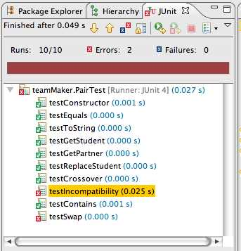
Viewing results in Eclipse
Ran 10 of
the 10 tests
No tests
failed, but...
Something unexpected
happened in two tests
Bar is green if
all tests pass,
red otherwise
This is how
long the
test took
This test passed
Something is wrong
Depending on your
preferences, this
window might show
only failed tests

Slide 106
Recommended approach
Write a test for some method you intend to write
If the method is fairly complex, test only the simplest case
Write a stub for the method
Run the test and make sure it fails
Replace the stub with code
Write just enough code to pass the tests
Run the test
If it fails, debug the method (or maybe debug the test); repeat until the test passes
If the method needs to do more, or handle more complex situations, add the tests for these first, and go back to step 3

Slide 108

Bugs and testing
software reliability: Probability that a software system will not cause failure under specified conditions.
Measured by uptime, MTTF (mean time till failure), crash data.
Bugs are inevitable in any complex software system.
Industry estimates: 10-50 bugs per 1000 lines of code.
A bug can be visible or can hide in your code until much later.
testing: A systematic attempt to reveal errors.
Failed test: an error was demonstrated.
Passed test: no error was found (for this particular situation).

Slide 109
Difficulties of testing
Perception by some developers and managers:
Testing is seen as a novice's job.
Assigned to the least experienced team members.
Done as an afterthought (if at all).
"My code is good; it won't have bugs. I don't need to test it."
"I'll just find the bugs by running the client program."
Limitations of what testing can show you:
It is impossible to completely test a system.
Testing does not always directly reveal the actual bugs in the code.
Testing does not prove the absence of errors in software.

Slide 110

Unit testing
unit testing: Looking for errors in a subsystem in isolation.
Generally a "subsystem" means a particular class or object.
The Java library JUnit helps us to easily perform unit testing.
The basic idea:
For a given class Foo, create another class FooTest to test it, containing various "test case" methods to run.
Each method looks for particular results and passes / fails.
JUnit provides "assert" commands to help us write tests.
The idea: Put assertion calls in your test methods to check things you expect to be true. If they aren't, the test will fail.

Slide 111
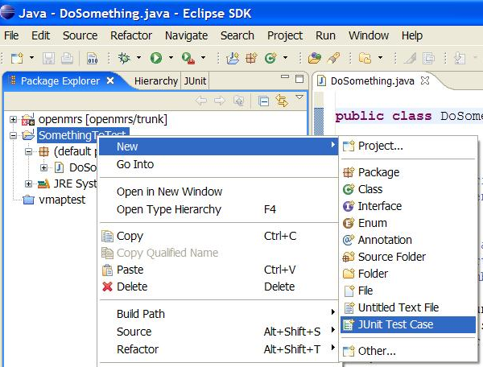
JUnit and Eclipse
To add JUnit to an Eclipse project, click:
Project → Properties → Build Path → Libraries → Add Library... → JUnit → JUnit 4 → Finish
To create a test case:
right-click a file and choose New → Test Case
or click File → New → JUnit Test Case
Eclipse can create stubs of method tests for you.

Slide 112
A JUnit test class
import org.junit.*;
import static org.junit.Assert.*;
public class name {
...
@Test
public void name() { // a test case method
...
}
}
A method with @Test is flagged as a JUnit test case.
All @Test methods run when JUnit runs your test class.

Slide 113
JUnit assertion methods
Each method can also be passed a string to display if it fails:
e.g. assertEquals("message", expected, actual)
Why is there no pass method?
assertTrue(test) | fails if the boolean test is false
assertFalse(test) | fails if the boolean test is true
assertEquals(expected, actual) | fails if the values are not equal
assertSame(expected, actual) | fails if the values are not the same (by ==)
assertNotSame(expected, actual) | fails if the values are the same (by ==)
assertNull(value) | fails if the given value is not null
assertNotNull(value) | fails if the given value is null
fail() | causes current test to immediately fail

Slide 114
ArrayIntList JUnit test
import org.junit.*;
import static org.junit.Assert.*;
public class TestArrayIntList {
@Test
public void testAddGet1() {
ArrayIntList list = new ArrayIntList();
list.add(42);
list.add(-3);
list.add(15);
assertEquals(42, list.get(0));
assertEquals(-3, list.get(1));
assertEquals(15, list.get(2));
}
@Test
public void testIsEmpty() {
ArrayIntList list = new ArrayIntList();
assertTrue(list.isEmpty());
list.add(123);
assertFalse(list.isEmpty());
list.remove(0);
assertTrue(list.isEmpty());
}
...

Slide 115
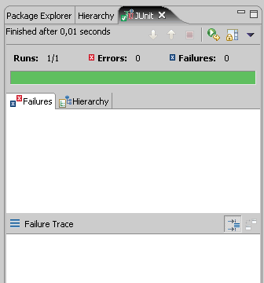
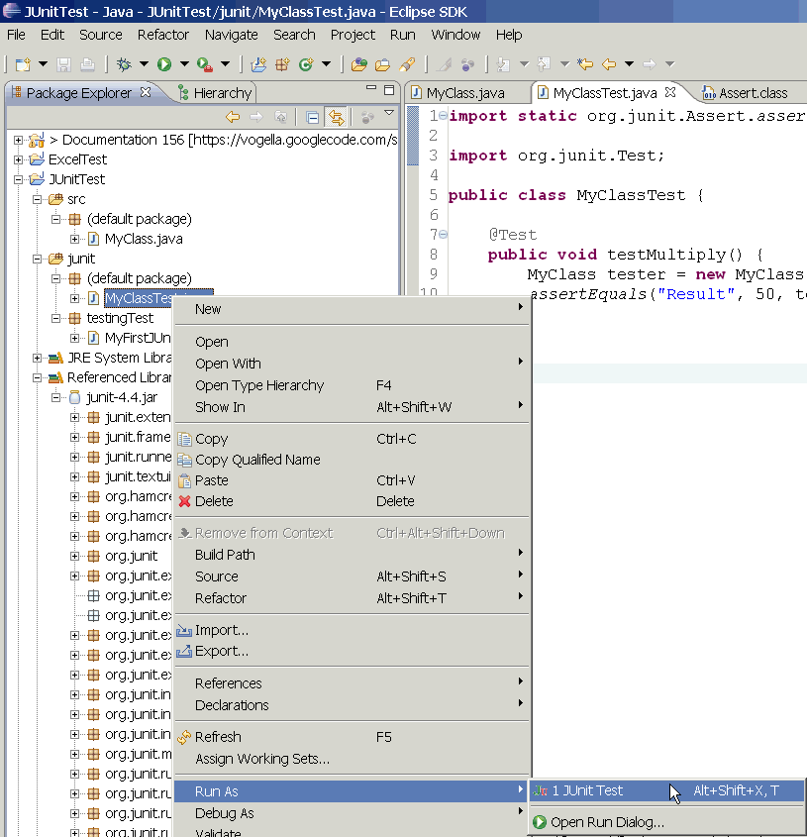
Running a test
Right click it in the Eclipse Package Explorer at left; choose:
Run As → JUnit Test
The JUnit bar will show green if all tests pass, red if any fail.
The Failure Trace shows which tests failed, if any, and why.

Slide 116
JUnit exercise
Given a Date class with the following methods:
public Date(int year, int month, int day)
public Date() // today
public int getDay(), getMonth(), getYear()
public void addDays(int days) // advances by days
public int daysInMonth()
public String dayOfWeek() // e.g. "Sunday"
public boolean equals(Object o)
public boolean isLeapYear()
public void nextDay() // advances by 1 day
public String toString()
Come up with unit tests to check the following:
That no Date object can ever get into an invalid state.
That the addDays method works properly.
It should be efficient enough to add 1,000,000 days in a call.
Notes:
a good equals method has some initial checks like checking for null, checking whether this == that, check instanceof, etc... then it calls compareTo

Slide 117
What's wrong with this?
public class DateTest {
@Test
public void test1() {
Date d = new Date(2050, 2, 15);
d.addDays(4);
assertEquals(d.getYear(), 2050);
assertEquals(d.getMonth(), 2);
assertEquals(d.getDay(), 19);
}
@Test
public void test2() {
Date d = new Date(2050, 2, 15);
d.addDays(14);
assertEquals(d.getYear(), 2050);
assertEquals(d.getMonth(), 3);
assertEquals(d.getDay(), 1);
}
}

Slide 118
Well-structured assertions
public class DateTest {
@Test
public void test1() {
Date d = new Date(2050, 2, 15);
d.addDays(4);
assertEquals(2050, d.getYear()); // expected
assertEquals(2, d.getMonth()); // value should
assertEquals(19, d.getDay()); // be at LEFT
}
@Test
public void test2() {
Date d = new Date(2050, 2, 15);
d.addDays(14);
assertEquals("year after +14 days", 2050, d.getYear());
assertEquals("month after +14 days", 3, d.getMonth());
assertEquals("day after +14 days", 1, d.getDay());
} // test cases should usually have messages explaining
} // what is being checked, for better failure output

Slide 119
Expected answer objects
public class DateTest {
@Test
public void test1() {
Date d = new Date(2050, 2, 15);
d.addDays(4);
Date expected = new Date(2050, 2, 19);
assertEquals(expected, d); // use an expected answer
} // object to minimize tests
// (Date must have toString
@Test // and equals methods)
public void test2() {
Date d = new Date(2050, 2, 15);
d.addDays(14);
Date expected = new Date(2050, 3, 1);
assertEquals("date after +14 days", expected, d);
}
}

Slide 120
Naming test cases
public class DateTest {
@Test
public void test_addDays_withinSameMonth_1() {
Date actual = new Date(2050, 2, 15);
actual.addDays(4);
Date expected = new Date(2050, 2, 19);
assertEquals("date after +4 days", expected, actual);
}
// give test case methods really long descriptive names
@Test
public void test_addDays_wrapToNextMonth_2() {
Date actual = new Date(2050, 2, 15);
actual.addDays(14);
Date expected = new Date(2050, 3, 1);
assertEquals("date after +14 days", expected, actual);
}
// give descriptive names to expected/actual values
}

Slide 121
What's wrong with this?
public class DateTest {
@Test
public void test_addDays_addJustOneDay_1() {
Date actual = new Date(2050, 2, 15);
actual.addDays(1);
Date expected = new Date(2050, 2, 16);
assertEquals(
"should have gotten " + expected + "\n" +
" but instead got " + actual\n",
expected, actual);
}
...
}

Slide 122
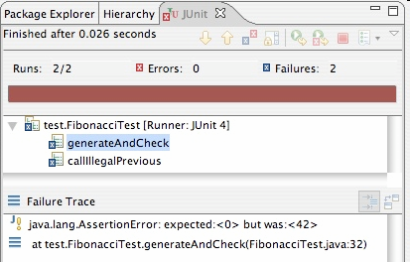
Good assertion messages
public class DateTest {
@Test
public void test_addDays_addJustOneDay_1() {
Date actual = new Date(2050, 2, 15);
actual.addDays(1);
Date expected = new Date(2050, 2, 16);
assertEquals("adding one day to 2050/2/15",
expected, actual);
}
...
}
// JUnit will already show
// the expected and actual
// values in its output;
//
// don't need to repeat them
// in the assertion message

Slide 123
Tests with a timeout
@Test(timeout = 5000)
public void name() { ... }
The above method will be considered a failure if it doesn't finish running within 5000 ms
private static final int TIMEOUT = 2000;
...
@Test(timeout = TIMEOUT)
public void name() { ... }
Times out / fails after 2000 ms

Slide 124
Pervasive timeouts
public class DateTest {
@Test(timeout = DEFAULT_TIMEOUT)
public void test_addDays_withinSameMonth_1() {
Date d = new Date(2050, 2, 15);
d.addDays(4);
Date expected = new Date(2050, 2, 19);
assertEquals("date after +4 days", expected, d);
}
@Test(timeout = DEFAULT_TIMEOUT)
public void test_addDays_wrapToNextMonth_2() {
Date d = new Date(2050, 2, 15);
d.addDays(14);
Date expected = new Date(2050, 3, 1);
assertEquals("date after +14 days", expected, d);
}
// almost every test should have a timeout so it can't
// lead to an infinite loop; good to set a default, too
private static final int DEFAULT_TIMEOUT = 2000;
}

Slide 125
Testing for exceptions
@Test(expected = ExceptionType.class)
public void name() {
...
}
Will pass if it does throw the given exception.
If the exception is not thrown, the test fails.
Use this to test for expected errors.
@Test(expected = ArrayIndexOutOfBoundsException.class)
public void testBadIndex() {
ArrayIntList list = new ArrayIntList();
list.get(4); // should fail
}

Slide 126
Setup and teardown
@Before
public void name() { ... }
@After
public void name() { ... }
methods to run before/after each test case method is called
@BeforeClass
public static void name() { ... }
@AfterClass
public static void name() { ... }
methods to run once before/after the entire test class runs

Slide 127
Tips for testing
You cannot test every possible input, parameter value, etc.
So you must think of a limited set of tests likely to expose bugs.
Think about boundary cases
positive; zero; negative numbers
right at the edge of an array or collection's size
Think about empty cases and error cases
0, -1, null; an empty list or array
test behavior in combination
maybe add usually works, but fails after you call remove
make multiple calls; maybe size fails the second time only

Slide 128
What's wrong with this?
public class DateTest {
// test every day of the year
@Test(timeout = 10000)
public void tortureTest() {
Date date = new Date(2050, 1, 1);
int month = 1;
int day = 1;
for (int i = 1; i < 365; i++) {
date.addDays(1);
if (day < DAYS_PER_MONTH[month]) {day++;}
else {month++; day=1;}
assertEquals(new Date(2050, month, day), date);
}
}
private static final int[] DAYS_PER_MONTH = {
0, 31, 28, 31, 30, 31, 30, 31, 31, 30, 31, 30, 31
}; // Jan Feb Mar Apr May Jun Jul Aug Sep Oct Nov Dec
}

Slide 129
Trustworthy tests
Test one thing at a time per test method.
10 small tests are much better than 1 test 10x as large.
Each test method should have few (likely 1) assert statements.
If you assert many things, the first that fails stops the test.
You won't know whether a later assertion would have failed.
Tests should avoid logic.
minimize if/else, loops, switch, etc.
avoid try/catch
If it's supposed to throw, use expected= ... if not, let JUnit catch it.
Torture tests are okay, but only in addition to simple tests.

Slide 130
JUnit exercise
Given our Date class seen previously:
public Date(int year, int month, int day)
public Date() // today
public int getDay(), getMonth(), getYear()
public void addDays(int days) // advances by days
public int daysInMonth()
public String dayOfWeek() // e.g. "Sunday"
public boolean equals(Object o)
public boolean isLeapYear()
public void nextDay() // advances by 1 day
public String toString()
Come up with unit tests to check the following:
That no Date object can ever get into an invalid state.
That the addDays method works properly.
It should be efficient enough to add 1,000,000 days in a call.
Notes:
a good equals method has some initial checks like checking for null, checking whether this == that, check instanceof, etc... then it calls compareTo

Slide 131
Squashing redundancy
public class DateTest {
@Test(timeout = DEFAULT_TIMEOUT)
public void addDays_withinSameMonth_1() {
addHelper(2050, 2, 15, +4, 2050, 2, 19);
}
@Test(timeout = DEFAULT_TIMEOUT)
public void addDays_wrapToNextMonth_2() {
addHelper(2050, 2, 15, +14, 2050, 3, 1);
}
// use lots of helpers to make actual tests extremely short
private void addHelper(int y1, int m1, int d1, int add,
int y2, int m2, int d2) {
Date act = new Date(y, m, d);
actual.addDays(add);
Date exp = new Date(y2, m2, d2);
assertEquals("after +" + add + " days", exp, act);
}
// can also use "parameterized tests" in some frameworks
...

Slide 132
Flexible helpers
public class DateTest {
@Test(timeout = DEFAULT_TIMEOUT)
public void addDays_multipleCalls_wrapToNextMonth2x() {
Date d = addHelper(2050, 2, 15, +14, 2050, 3, 1);
addhelper(d, +32, 2050, 4, 2);
addhelper(d, +98, 2050, 7, 9);
}
// Helpers can box you in; hard to test many calls/combine.
// Create variations that allow better flexibility
private Date addHelper(int y1, int m1, int d1, int add,
int y2, int m2, int d2) {
Date date = new Date(y, m, d);
addHelper(date, add, y2, m2, d2);
return d;
}
private void addHelper(Date date, int add,
int y2, int m2, int d2) {
date.addDays(add);
Date expect = new Date(y2, m2, d2);
assertEquals("date after +" + add + " days", expect, d);
}
...

Slide 133
Regression testing
regression: When a feature that used to work, no longer works.
Likely to happen when code changes and grows over time.
A new feature/fix can cause a new bug or reintroduce an old bug.
regression testing: Re-executing prior unit tests after a change.
Often done by scripts during automated testing.
Used to ensure that old fixed bugs are still fixed.
Gives your app a minimum level of working functionality.
Many products have a set of mandatory check-in tests that must pass before code can be added to a source code repository.

Slide 134
Test-driven development
Unit tests can be written after, during, or even before coding.
test-driven development: Write tests, then write code to pass them.
Imagine that we'd like to add a method subtractWeeks to our Date class, that shifts this Date backward in time by the given number of weeks.
Write code to test this method before it has been written.
Then once we do implement the method, we'll know if it works.

Slide 135
Tests and data structures
Need to pass lots of arrays? Use array literals
public void exampleMethod(int[] values) { ... }
...
exampleMethod(new int[] {1, 2, 3, 4});
exampleMethod(new int[] {5, 6, 7});
Need a quick ArrayList? Try Arrays.asList
List<Integer> list = Arrays.asList(7, 4, -2, 3, 9, 18);
Need a quick set, queue, etc.? Many collections can take a list
Set<Integer> list = new HashSet<Integer>(
Arrays.asList(7, 4, -2, 9));

Slide 136
What's wrong with this?
public class DateTest {
// shared Date object to test with (saves memory!!1)
private static Date DATE;
@Test(timeout = DEFAULT_TIMEOUT)
public void addDays_sameMonth() {
DATE = new Date(2050, 2, 15); // first test;
addhelper(DATE, +4, 2050, 2, 19); // DATE = 2/15 here
}
@Test(timeout = DEFAULT_TIMEOUT)
public void addDays_nextMonthWrap() { // second test;
addhelper(DATE, +10, 2050, 3, 1); // DATE = 2/19 here
}
@Test(timeout = DEFAULT_TIMEOUT)
public void addDays_multipleCalls() { // third test;
addDays_sameMonth(); // go back to 2/19;
addhelper(DATE, +1, 2050, 2, 20); // test two calls
addhelper(DATE, +1, 2050, 2, 21);
}
...
}

Slide 137

Test case "smells"
Tests should be self-contained and not care about each other.
"Smells" (bad things to avoid) in tests:
Constrained test order : Test A must run before Test B. (usually a misguided attempt to test order/flow)
Tests call each other : Test A calls Test B's method (calling a shared helper is OK, though)
Mutable shared state : Tests A/B both use a shared object. (If A breaks it, what happens to B?)

Slide 138
Test suites
test suite: One class that runs many JUnit tests.
An easy way to run all of your app's tests at once.
import org.junit.runner.*;
import org.junit.runners.*;
@RunWith(Suite.class)
@Suite.SuiteClasses({
TestCaseName.class,
TestCaseName.class,
...
TestCaseName.class,
})
public class name {}

Slide 139
Test suite example
import org.junit.runner.*;
import org.junit.runners.*;
@RunWith(Suite.class)
@Suite.SuiteClasses({
WeekdayTest.class,
TimeTest.class,
CourseTest.class,
ScheduleTest.class,
CourseComparatorsTest.class
})
public class HW2Tests {}

Slide 140
JUnit summary
Tests need failure atomicity (ability to know exactly what failed).
Each test should have a clear, long, descriptive name.
Assertions should always have clear messages to know what failed.
Write many small tests, not one big test.
Each test should have roughly just 1 assertion at its end.
Always use a timeout parameter to every test.
Test for expected errors / exceptions.
Choose a descriptive assert method, not always assertTrue.
Choose representative test cases from equivalent input classes.
Avoid complex logic in test methods if possible.
Use helpers, @Before to reduce redundancy between tests.

Slide 142
JUnit
A tool for test-driven development

Slide 143
History
Kent Beck developed the first xUnit automated test tool for Smalltalk in mid-90’s
Beck and Gamma (of design patterns Gang of Four) developed JUnit on a flight from Zurich to Washington, D.C.
Martin Fowler: “Never in the field of software development was so much owed by so many to so few lines of code.”
Junit has become the standard tool for Test-Driven Development in Java (see Junit.org)
Junit test generators now part of many Java IDEs (Eclipse, BlueJ, Jbuilder, DrJava)
Xunit tools have since been developed for many other languages (Perl, C++, Python, Visual Basic, C#, …)

Slide 144
Why create a test suite?
Obviously you have to test your code—right?
You can do ad hoc testing (running whatever tests occur to you at the moment), or
You can build a test suite (a thorough set of tests that can be run at any time)
Disadvantages of a test suite
It’s a lot of extra programming
True, but use of a good test framework can help quite a bit
You don’t have time to do all that extra work
False! Experiments repeatedly show that test suites reduce debugging time more than the amount spent building the test suite
Advantages of a test suite
Reduces total number of bugs in delivered code
Makes code much more maintainable and refactorable

Slide 145
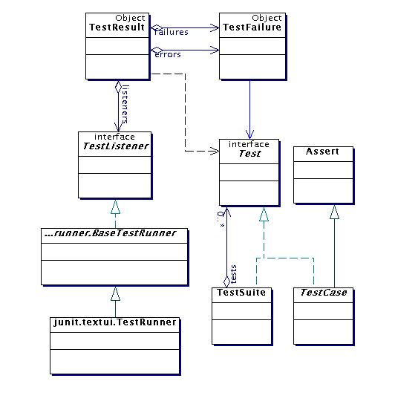
Architectural overview
JUnit test framework is a package of classes that lets you write tests for each method, then easily run those tests
TestRunner runs tests and reports TestResults
You test your class by extending abstract class TestCase
To write test cases, you need to know and understand the Assert class

Slide 146
Writing a TestCase
To start using JUnit, create a subclass of TestCase, to which you add test methods
Here’s a skeletal test class:
import junit.framework.TestCase;
public class TestBowl extends TestCase {
} //Test my class Bowl
Name of class is important – should be of the form TestMyClass or MyClassTest
This naming convention lets TestRunner automatically find your test classes

Slide 147
Writing methods in TestCase
Pattern follows programming by contract paradigm:
Set up preconditions
Exercise functionality being tested
Check postconditions
Example:
public void testEmptyList() {
Bowl emptyBowl = new Bowl();
assertEquals(“Size of an empty list should be zero.”,
0, emptyList.size());
assertTrue(“An empty bowl should report empty.”, emptyBowl.isEmpty());
}
Things to notice:
Specific method signature – public void testWhatever()
Allows them to be found and collected automatically by JUnit
Coding follows pattern
Notice the assert-type calls…

Slide 148
Assert methods
Each assert method has parameters like these: message, expected-value, actual-value
Assert methods dealing with floating point numbers get an additional argument, a tolerance
Each assert method has an equivalent version that does not take a message – however, this use is not recommended because:
messages helps documents the tests
messages provide additional information when reading failure logs

Slide 149
Assert methods
assertTrue(String message, Boolean test)
assertFalse(String message, Boolean test)
assertNull(String message, Object object)
assertNotNull(String message, Object object)
assertEquals(String message, Object expected, Object actual) (uses equals method)
assertSame(String message, Object expected, Object actual) (uses == operator)
assertNotSame(String message, Object expected, Object actual)

Slide 150
More stuff in test classes
Suppose you want to test a class Counter
public class CounterTest extends junit.framework.TestCase {
This is the unit test for the Counter class
public CounterTest() { } //Default constructor
protected void setUp()
Test fixture creates and initializes instance variables, etc.
protected void tearDown()
Releases any system resources used by the test fixture
public void testIncrement(), public void testDecrement()
These methods contain tests for the Counter methods increment(), decrement(), etc.
Note capitalization convention

Slide 151
JUnit tests for Counter
public class CounterTest extends junit.framework.TestCase { Counter counter1; public CounterTest() { } // default constructor
protected void setUp() { // creates a (simple) test fixture counter1 = new Counter(); }
public void testIncrement() { assertTrue(counter1.increment() == 1); assertTrue(counter1.increment() == 2); }
public void testDecrement() { assertTrue(counter1.decrement() == -1); } }
Note that each test begins with a brand new counter
This means you don’t have to worry about the order in which the tests are run

Slide 152
TestSuites
TestSuites collect a selection of tests to run them as a unit
Collections automatically use TestSuites, however to specify the order in which tests are run, write your own:
public static Test suite() {
suite.addTest(new TestBowl(“testBowl”));
suite.addTest(new TestBowl(“testAdding”));
return suite;
}
Should seldom have to write your own TestSuites as each method in your TestCase should be independent of all others
Can create TestSuites that test a whole package:
public static Test suite() {
TestSuite suite = new TestSuite();
suite.addTestSuite(TestBowl.class);
suite.addTestSuite(TestFruit.class);
return suite;
}

Slide 153
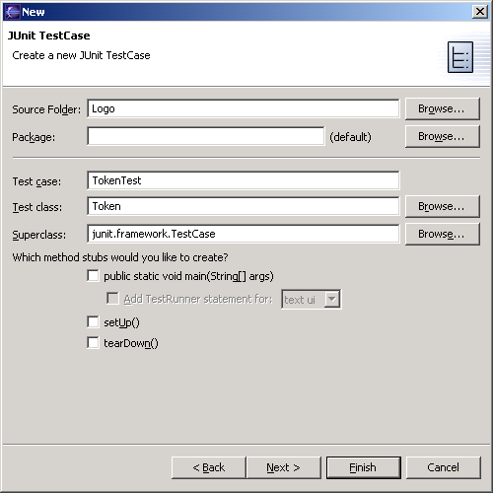
JUnit in Eclipse
To create a test class, select File→ New→ Other... → Java, JUnit, TestCase and enter the name of the class you will test
Fill this in
This will be filled in automatically

Slide 154

Running JUnit
Second, use this pulldown menu
First, select a Test class
Third, Run As → JUnit Test

Slide 155

Results
Your results are here

Slide 156
Unit testing for other languages
Unit testing tools differentiate between:
Errors (unanticipated problems caught by exceptions)
Failures (anticipated problems checked with assertions)
Basic unit of testing:
CPPUNIT_ASSERT(Bool) examines an expression
CPPUnit has variety of test classes (e.g. TestFixture)
Inherit from them and overload methods

Slide 158
What is Test Driven Development & JUnit?
Test driven development (TDD) is one of the most successful productivity enhancing techniques used by many in eXtreme Programming. TDD has three step: write test, write code & refactor.
JUnit is an open source Java testing framework used in TDD. JUnit was originally written by Erich Gamma and Kent Beck. It is an instance of the xUnit architecture for unit testing frameworks.

Slide 159
Design of JUnit
JUnit is designed around two key design patterns: the Command pattern and the Composite pattern.
A TestCase is a Command object. It can define any number of public testXXX() methods and any test class that has test methods should extend the TestCase class.

Slide 160
Desgin of JUnit (2)
The test class can use the setUp() and tearDown() methods to initialize and release common objects under test, referred to as the test fixture.
TestCase instances can be composed into TestSuites that can automatically invoke all the testXXX() in each TestCase instance. TestSuite can also have other TestSuite instances and this allows the test to run automatically and provide test status.

Slide 161
How to install JUnit?
First, download the latest version of JUnit from http://www.junit.org (Note: Eclipse should already have JUnit installed.)
For installing JUnit on Windows:
Unzip the junit.zip to %JUNIT_HOME%
Add JUnit to classpath:
set CLASSPATH=%JUNIT_HOME%\junit.jar
For installing JUnit on UNIX:

Slide 162
How to install Junit? (2)
Unzip the junit.zip to $JUNIT_HOME
Add JUnit to classpath:
export CLASSPATH=$JUNIT_HOME/junit.jar
Test installation by using the textual or graphical test runner to run the sample tests distributed with JUnit.
All tests should pass with an “OK” or a green bar. If not, then verify that junit.jar is in the CLASSPATH

Slide 163
How to write JUnit Test Case?
To write a test case follows these steps:
Define a subclass of TestCase.
Overide the setUp() method to initialize objects under test.
Optionally overide tearDown() method to release object under test.
Define one or more public testXXX() methods that exercise the objects under test.

Slide 164
Sample Test Case
import junit.framework.TestCase;
public class ShoppingCartTest extends TestCase {
private ShoppingCart cart;
private Product book1;
// Sets up the test fixture.
//Called before every testcase method.
protected void setUp() {
cart = new ShoppingCart();

Slide 165
Sample Test Case (2)
book1 = new Product("Pragmatic Unit Testing", 29.95);
cart.addItem(book1);
}
//Tears down the test fixture.
//Called after every test case method.
protected void tearDown() {
// release objects under test here
}
//Tests emptying the cart.

Slide 166
Sample Test Case (3)
public void testEmpty() {
cart.empty();
assertEquals(0, cart.getItemCount());
}
...
};

Slide 167
How to write JUnit Test Suite?
A TestSuite comprises of various TestCase instances.
To write a test suite follow these steps:
Create a class that defines a static suite() factory method which creates TestSuites for all tests.
Optionally define a main() method that runs the TestSuite in batch mode.

Slide 168
Sample Test Suite
import junit.framework.Test;
import junit.framework.TestSuite;
public class EcommerceTestSuite {
public static Test suite() {
TestSuite suite = new TestSuite();
// The ShoppingCartTest we created above.
suite.addTestSuite(ShoppingCartTest.class)

Slide 169
Sample Test Suite (2)
// Another example test suite of tests.
suite.addTest(CreditCardTestSuite.suite());
// Add more tests here
return suite;
}
//Runs the test suite using the textual runner.
public static void main(String[] args) {
junit.textui.TestRunner.run(suite());
}

Slide 170
How to Run JUnit tests?
JUnit provides textual and graphical interface (GI) to run tests. Both interface indicates how many tests were run, errors or failures and test status, “OK” for textual and green bar in GI.
For running tests from textual interface: java junit.textui.TestRunner ShoppingCartTest
For running tests from graphical interface: java junit.swingui.TestRunner ShoppingCartTest

Slide 171
Assertions for JUnit
JUnit uses assertion methods to test conditions:
assertEquals(a,b) – a and b must be primitives or have an equals method for comparison
assertFalse(a) - a must be boolean
assertNotNull(a) - a is either object or null
assertNotSame(a,b) – test for object equality
assertNull(a) - a is either object or null
assertSame(a,b) – test for object equality
assertTrue(a) - a must be boolean

Slide 172
Why use JUnit?
Its free!
It is simple and elegant to use.
It is easy and inexpensive to write tests using the JUnit testing framework.
JUnit tests checks their own result and provide quick visual feedback.
Tests can be composed into TestSuites.
It is integrated into IDE’s like Eclipse and NetBeans.

Slide 174
Agile Penetration @ Organization
Agile Related Information
Type of Project (please elaborate) | ATG ecommerce implementation. Re-platform website, in-store and customer services.
Domains | Retail Ecommerce
Technologies | ATG, Java.
Practices | Behavior Driven Development (BDD), TDD
Agile Institutionalized since | 2010
Key success factor 1 | Rolled out TDD & BDD to few Engineering teams
Key success factor 2 | Enabled Continuous Delivery
Key success factor 3

Slide 175
Agile Execution @ Project A
Project Name | Customer Service Center – Returns/Replacements
Project Size | 50
Project Structure | Various Scrum teams spread across UK and India(Bangalore, Hyderabad).
Agile Approach | SCRUM, TDD, BDD
Agile Practices | Spike solution, Sprint, Standup meeting, continuous integration, Automated Testing, code refactoring, design refactoring
Agile Metrics | Product velocity, burn down, various levels of Automation ( Smoke Tests, Sanity Tests, Functional Tests)
Agile Tools | Scrum Works, Jbehave(BDD), Mockito (TDD), Hudson (CI), Rally.
Agile Skills | TDD, Story Breakdown, Scrum Planning
Why Agile in this project | Business Feedback, Reliable Delivery

Slide 176
Behavior Driven Development
It is an evolution of
Test Driven Development (TDD)
Acceptance Test Driven Development (ATDD).
It makes TDD and ATDD easy for new comers and experts
Notes:
Note:

Slide 177
How we did it
Created small vertical stories of business value.
Agreed & documented business rules.
Agreed & documented the behavior.
Agreed how story would be accepted.
Created executable scenarios for each behavior.
Given, When and Then.
Verified it by the stake holders and rest of the teams.
Developed the behavior and verified the scenarios.
Show & Tell of completed scenarios to Truth.
Reacted to feedback.
Accepted story’s scenario added to regression suite.

Slide 178

The BDD Framework

Slide 179
The JUnit Framework
BDD simplified functional testing.
BDD also simplifies JUnit testing.
JUnit is testing java components at the unit level.
JUnit verifies components behavior without deployments.
It does not need any dependencies to be available.
Tools used : Mockito

Slide 180
Why Mockito
Enables creation of Mock objects, verification of behavior and stubbing.
Provides BDD style structure.
Enables testing of unit level components.
Like Server side components, Database components etc..
Mock all objects that a component uses and verifies its use according to specified behavior.

Slide 181

The Big picture – what we achieved

Slide 182
Significant Benefits
Focused on development and delivery of prioritised, verifiable business stories.
Focused on providing a common vocabulary that bridges the gap between business and technology.
Focuses on exposing business rules to review by stake holders and Testing Teams.
Encourages collaboration between developers, testers, architects, BA’s and Business.
Made it easy to Automate End to End functional testing.
Simplified Test Driven Development.
All integrated well on Continuous Integration
The Business where satisfied to see the status of project.

Slide 183
Limitations
Due to time constraints we could not automate all scenarios.
Due to Infrastructure limitations could not run automated regression suite on every check-in.
Due to time constraints not all teams followed TDD.
Some legacy application testing could not be fully automated.
Not all teams where empowered to take decision of TDD.
Given tight deadlines the some teams abandoned TDD.

Slide 184
Recommendations
More stake holder involvements in defining test scenarios.
More encouragement from management to engineering to adopt TDD/BDD.
To user business friendly tools like Fitnesse or Cucumber.
Invest in CI infrastructure to run automated regression suite on every check in.

